Slide 1

14
PARTIAL DERIVATIVES

Slide 2
PARTIAL DERIVATIVES
14.6
Directional Derivatives and the Gradient Vector
In this section, we will learn how to find:
The rate of changes of a function of
two or more variables in any direction.
Notes:
CHECK IF ACCURATE.

Slide 3
INTRODUCTION
This weather map shows a contour map of the temperature function T(x, y) for:
The states of California and Nevada at 3:00 PM on a day in October.

Slide 4
INTRODUCTION
The level curves, or isothermals, join locations with the same temperature.

Slide 5
INTRODUCTION
The partial derivative T_{x} is the rate of change of temperature with respect to distance if we travel east from Reno.
T_{y} is the rate of change if we travel north.

Slide 6
INTRODUCTION
However, what if we want to know the rate of change when we travel southeast (toward Las Vegas), or in some other direction?

Slide 7
DIRECTIONAL DERIVATIVE
In this section, we introduce a type of derivative, called a directional derivative, that enables us to find:
The rate of change of a function of two or more variables in any direction.

Slide 8
DIRECTIONAL DERIVATIVES
Equations 1
Recall that, if z = f(x, y), then the partial derivatives f_{x} and f_{y} are defined as:

Slide 9
DIRECTIONAL DERIVATIVES
Equations 1
They represent the rates of change of z in the x- and y-directions—that is, in the directions of the unit vectors i and j.

Slide 10
DIRECTIONAL DERIVATIVES
Suppose that we now wish to find the rate of change of z at (x₀, y₀) in the direction of an arbitrary unit vector u = <a, b>.

Slide 11
DIRECTIONAL DERIVATIVES
To do this, we consider the surface S with equation z = f(x, y) [the graph of f ] and we let z₀ = f(x₀, y₀).
Then, the point P(x₀, y₀, z₀) lies on S.

Slide 12
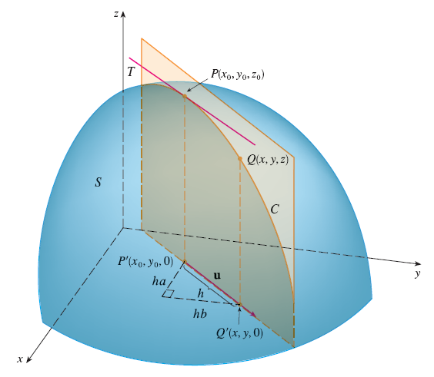
DIRECTIONAL DERIVATIVES
The vertical plane that passes through P in the direction of u intersects S in a curve C.

Slide 13
DIRECTIONAL DERIVATIVES
The slope of the tangent line T to C at the point P is the rate of change of z in the direction of u.

Slide 14
DIRECTIONAL DERIVATIVES
Now, let:
Q(x, y, z) be another point on C.
P’, Q’ be the projections of P, Q on the xy-plane.

Slide 15
DIRECTIONAL DERIVATIVES
Then, the vector is parallel to u.
So, for some scalar h.

Slide 16
DIRECTIONAL DERIVATIVES
Therefore, x – x₀ = ha y – y₀ = hb

Slide 17
DIRECTIONAL DERIVATIVES
So, x = x₀ + ha y = y₀ + hb

Slide 18
DIRECTIONAL DERIVATIVE
If we take the limit as h → 0, we obtain the rate of change of z (with respect to distance) in the direction of u.
This is called the directional derivative of f in the direction of u.

Slide 19
DIRECTIONAL DERIVATIVE
Definition 2
The directional derivative of f at (x₀, y₀) in the direction of a unit vector u = <a, b> is: if this limit exists.

Slide 20
DIRECTIONAL DERIVATIVES
Comparing Definition 2 with Equations 1, we see that:
If u = i = <1, 0>, then D_{i} f = f_{x}.
If u = j = <0, 1>, then D_{j} f = f_{y}.

Slide 21
DIRECTIONAL DERIVATIVES
In other words, the partial derivatives of f with respect to x and y are just special cases of the directional derivative.

Slide 22
DIRECTIONAL DERIVATIVES
Example 1
Use this weather map to estimate the value of the directional derivative of the temperature function at Reno in the southeasterly direction.

Slide 23
DIRECTIONAL DERIVATIVES
Example 1
The unit vector directed toward the southeast is: u = (i – j)/
However, we won’t need to use this expression.

Slide 24
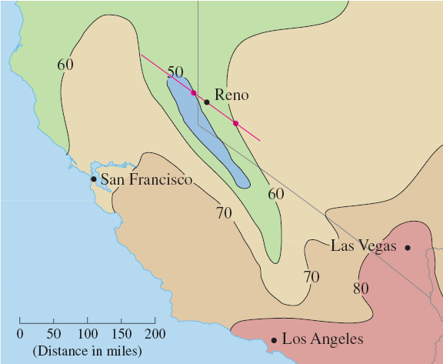
DIRECTIONAL DERIVATIVES
Example 1
We start by drawing a line through Reno toward the southeast.

Slide 25
DIRECTIONAL DERIVATIVES
Example 1
We approximate the directional derivative D_{u}T by:
The average rate of change of the temperature between the points where this line intersects the isothermals T = 50 and T = 60.

Slide 26
DIRECTIONAL DERIVATIVES
Example 1
The temperature at the point southeast of Reno is T = 60°F.
The temperature at the point northwest of Reno is T = 50°F.

Slide 27
DIRECTIONAL DERIVATIVES
Example 1
The distance between these points looks to be about 75 miles.

Slide 28
DIRECTIONAL DERIVATIVES
Example 1
So, the rate of change of the temperature in the southeasterly direction is:

Slide 29
DIRECTIONAL DERIVATIVES
When we compute the directional derivative of a function defined by a formula, we generally use the following theorem.

Slide 30
DIRECTIONAL DERIVATIVES
Theorem 3
If f is a differentiable function of x and y, then f has a directional derivative in the direction of any unit vector u = <a, b> and

Slide 31
DIRECTIONAL DERIVATIVES
Proof
If we define a function g of the single variable h by then, by the definition of a derivative, we have the following equation.

Slide 32
DIRECTIONAL DERIVATIVES
Proof—Equation 4

Slide 33
DIRECTIONAL DERIVATIVES
Proof
On the other hand, we can write: g(h) = f(x, y)
where:
x = x₀ + ha
y = y₀ + hb

Slide 34
DIRECTIONAL DERIVATIVES
Proof
Hence, the Chain Rule (Theorem 2 in Section 14.5) gives:

Slide 35
DIRECTIONAL DERIVATIVES
Proof—Equation 5
If we now put h = 0, then x = x₀ y = y₀ and

Slide 36
DIRECTIONAL DERIVATIVES
Proof
Comparing Equations 4 and 5, we see that:

Slide 37
DIRECTIONAL DERIVATIVES
Suppose the unit vector u makes an angle θ with the positive x-axis, as shown.

Slide 38
DIRECTIONAL DERIVATIVES
Equation 6
Then, we can write u = <cos θ, sin θ> and the formula in Theorem 3 becomes:

Slide 39
DIRECTIONAL DERIVATIVES
Example 2
Find the directional derivative D_{u}f(x, y) if:
f(x, y) = x³ – 3xy + 4y²
u is the unit vector given by angle θ = π/6
What is D_{u}f(1, 2)?

Slide 40
DIRECTIONAL DERIVATIVES
Example 2
Formula 6 gives:

Slide 41
DIRECTIONAL DERIVATIVES
Example 2
Therefore,

Slide 42
DIRECTIONAL DERIVATIVES
The directional derivative D_{u} f(1, 2) in Example 2 represents the rate of change of z in the direction of u.

Slide 43
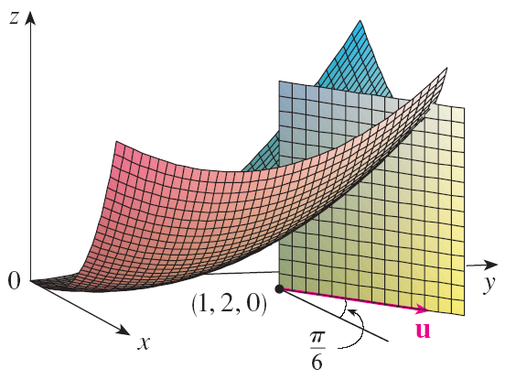
DIRECTIONAL DERIVATIVES
This is the slope of the tangent line to the curve of intersection of the surface z = x³ – 3xy + 4y² and the vertical plane through (1, 2, 0) in the direction of u shown here.

Slide 44
THE GRADIENT VECTOR
Expression 7
Notice from Theorem 3 that the directional derivative can be written as the dot product of two vectors:

Slide 45
THE GRADIENT VECTOR
The first vector in that dot product occurs not only in computing directional derivatives but in many other contexts as well.

Slide 46
THE GRADIENT VECTOR
So, we give it a special name:
The gradient of f
We give it a special notation too:
grad f or f , which is read “del f ”

Slide 47
THE GRADIENT VECTOR
Definition 8
If f is a function of two variables x and y, then the gradient of f is the vector function f defined by:

Slide 48
THE GRADIENT VECTOR
Example 3
If f(x, y) = sin x + e^{xy}, then

Slide 49
THE GRADIENT VECTOR
Equation 9
With this notation for the gradient vector, we can rewrite Expression 7 for the directional derivative as:
This expresses the directional derivative in the direction of u as the scalar projection of the gradient vector onto u.

Slide 50
THE GRADIENT VECTOR
Example 4
Find the directional derivative of the function f(x, y) = x²y³ – 4y at the point (2, –1) in the direction of the vector v = 2 i + 5 j.

Slide 51
THE GRADIENT VECTOR
Example 4
We first compute the gradient vector at (2, –1):

Slide 52
THE GRADIENT VECTOR
Example 4
Note that v is not a unit vector.
However, since , the unit vector in the direction of v is:

Slide 53
THE GRADIENT VECTOR
Example 4
Therefore, by Equation 9, we have:

Slide 54
FUNCTIONS OF THREE VARIABLES
For functions of three variables, we can define directional derivatives in a similar manner.
Again, D_{u} f(x, y, z) can be interpreted as the rate of change of the function in the direction of a unit vector u.

Slide 55
THREE-VARIABLE FUNCTION
Definition 10
The directional derivative of f at (x₀, y₀, z₀) in the direction of a unit vector u = <a, b, c> is: if this limit exists.

Slide 56
THREE-VARIABLE FUNCTIONS
If we use vector notation, then we can write both Definitions 2 and 10 of the directional derivative in a compact form, as follows.

Slide 57
THREE-VARIABLE FUNCTIONS
Equation 11
where:
x₀ = <x₀, y₀> if n = 2
x₀ = <x₀, y₀, z₀> if n = 3

Slide 58
THREE-VARIABLE FUNCTIONS
This is reasonable.
The vector equation of the line through x₀ in the direction of the vector u is given by x = x₀ + t u (Equation 1 in Section 12.5).
Thus, f(x₀ + hu) represents the value of f at a point on this line.

Slide 59
THREE-VARIABLE FUNCTIONS
Formula 12
If f(x, y, z) is differentiable and u = <a, b, c>, then the same method that was used to prove Theorem 3 can be used to show that:

Slide 60
THREE-VARIABLE FUNCTIONS
For a function f of three variables, the gradient vector, denoted by or grad f, is:

Slide 61
THREE-VARIABLE FUNCTIONS
Equation 13
For short,

Slide 62
THREE-VARIABLE FUNCTIONS
Equation 14
Then, just as with functions of two variables, Formula 12 for the directional derivative can be rewritten as:

Slide 63
THREE-VARIABLE FUNCTIONS
Example 5
If f(x, y, z) = x sin yz, find:
The gradient of f
The directional derivative of f at (1, 3, 0) in the direction of v = i + 2 j – k.

Slide 64
THREE-VARIABLE FUNCTIONS
Example 5 a
The gradient of f is:

Slide 65
THREE-VARIABLE FUNCTIONS
Example 5 b
At (1, 3, 0), we have:
The unit vector in the direction of v = i + 2 j – k is:

Slide 66
THREE-VARIABLE FUNCTIONS
Example 5
Hence, Equation 14 gives:

Slide 67
MAXIMIZING THE DIRECTIONAL DERIVATIVE
Suppose we have a function f of two or three variables and we consider all possible directional derivatives of f at a given point.
These give the rates of change of f in all possible directions.

Slide 68
MAXIMIZING THE DIRECTIONAL DERIVATIVE
We can then ask the questions:
In which of these directions does f change fastest?
What is the maximum rate of change?

Slide 69
MAXIMIZING THE DIRECTIONAL DERIVATIVE
The answers are provided by the following theorem.

Slide 70
MAXIMIZING DIRECTIONAL DERIV.
Theorem 15
Suppose f is a differentiable function of two or three variables.
The maximum value of the directional derivative D_{u}f(x) is:
It occurs when u has the same direction as the gradient vector

Slide 71
MAXIMIZING DIRECTIONAL DERIV.
Proof
From Equation 9 or 14, we have:
where θ is the angle between and u.

Slide 72
MAXIMIZING DIRECTIONAL DERIV.
Proof
The maximum value of cos θ is 1.
This occurs when θ = 0.
So, the maximum value of D_{u} f is:
It occurs when θ = 0, that is, when u has the same direction as .

Slide 73
MAXIMIZING DIRECTIONAL DERIV.
Example 6
If f(x, y) = xe^{y}, find the rate of change of f at the point P(2, 0) in the direction from P to Q(½, 2).

Slide 74
MAXIMIZING DIRECTIONAL DERIV.
Example 6
In what direction does f have the maximum rate of change? What is this maximum rate of change?

Slide 75
MAXIMIZING DIRECTIONAL DERIV.
Example 6 a
We first compute the gradient vector:

Slide 76
MAXIMIZING DIRECTIONAL DERIV.
Example 6 a
The unit vector in the direction of is .
So, the rate of change of f in the direction from P to Q is:

Slide 77
MAXIMIZING DIRECTIONAL DERIV.
Example 6 b
According to Theorem 15, f increases fastest in the direction of the gradient vector .
So, the maximum rate of change is:

Slide 78
MAXIMIZING DIRECTIONAL DERIV.
Example 7
Suppose that the temperature at a point (x, y, z) in space is given by T(x, y, z) = 80/(1 + x² + 2y² + 3z²) where:
T is measured in degrees Celsius.
x, y, z is measured in meters.

Slide 79
MAXIMIZING DIRECTIONAL DERIV.
Example 7
In which direction does the temperature increase fastest at the point (1, 1, –2)?
What is the maximum rate of increase?

Slide 80
MAXIMIZING DIRECTIONAL DERIV.
Example 7
The gradient of T is:

Slide 81
MAXIMIZING DIRECTIONAL DERIV.
Example 7
At the point (1, 1, –2), the gradient vector is:

Slide 82
MAXIMIZING DIRECTIONAL DERIV.
Example 7
By Theorem 15, the temperature increases fastest in the direction of the gradient vector
Equivalently, it does so in the direction of –i – 2 j + 6 k or the unit vector (–i – 2 j + 6 k)/ .

Slide 83
MAXIMIZING DIRECTIONAL DERIV.
Example 7
The maximum rate of increase is the length of the gradient vector:
Thus, the maximum rate of increase of temperature is:

Slide 84
TANGENT PLANES TO LEVEL SURFACES
Suppose S is a surface with equation F(x, y, z)
That is, it is a level surface of a function F of three variables.

Slide 85
TANGENT PLANES TO LEVEL SURFACES
Then, let P(x₀, y₀, z₀) be a point on S.

Slide 86
TANGENT PLANES TO LEVEL SURFACES
Then, let C be any curve that lies on the surface S and passes through the point P.
Recall from Section 13.1 that the curve C is described by a continuous vector function r(t) = <x(t), y(t), z(t)>

Slide 87
TANGENT PLANES TO LEVEL SURFACES
Let t₀ be the parameter value corresponding to P.
That is, r(t₀) = <x₀, y₀, z₀>

Slide 88
TANGENT PLANES
Equation 16
Since C lies on S, any point (x(t), y(t), z(t)) must satisfy the equation of S.
That is, F(x(t), y(t), z(t)) = k

Slide 89
TANGENT PLANES
Equation 17
If x, y, and z are differentiable functions of t and F is also differentiable, then we can use the Chain Rule to differentiate both sides of Equation 16:

Slide 90
TANGENT PLANES
However, as and Equation 17 can be written in terms of a dot product as:

Slide 91
TANGENT PLANES
Equation 18
In particular, when t = t₀, we have: r(t₀) = <x₀, y₀, z₀>
So,

Slide 92
TANGENT PLANES
Equation 18 says:
The gradient vector at P, , is perpendicular to the tangent vector r’(t₀) to any curve C on S that passes through P.

Slide 93
TANGENT PLANES
If , it is thus natural to define the tangent plane to the level surface F(x, y, z) = k at P(x₀, y₀, z₀) as:
The plane that passes through P and has normal vector

Slide 94
TANGENT PLANES
Equation 19
Using the standard equation of a plane (Equation 7 in Section 12.5), we can write the equation of this tangent plane as:

Slide 95
NORMAL LINE
The normal line to S at P is the line:
Passing through P
Perpendicular to the tangent plane

Slide 96
TANGENT PLANES
Thus, the direction of the normal line is given by the gradient vector

Slide 97
TANGENT PLANES
Equation 20
So, by Equation 3 in Section 12.5, its symmetric equations are:

Slide 98
TANGENT PLANES
Consider the special case in which the equation of a surface S is of the form z = f(x, y)
That is, S is the graph of a function f of two variables.

Slide 99
TANGENT PLANES
Then, we can rewrite the equation as F(x, y, z) = f(x, y) – z = 0 and regard S as a level surface (with k = 0) of F.

Slide 100
TANGENT PLANES
Then,

Slide 101
TANGENT PLANES
So, Equation 19 becomes:
This is equivalent to Equation 2 in Section 14.4

Slide 102
TANGENT PLANES
Thus, our new, more general, definition of a tangent plane is consistent with the definition that was given for the special case of Section 14.4

Slide 103
TANGENT PLANES
Example 8
Find the equations of the tangent plane and normal line at the point (–2, 1, –3) to the ellipsoid

Slide 104
TANGENT PLANES
Example 8
The ellipsoid is the level surface (with k = 3) of the function

Slide 105
TANGENT PLANES
Example 8
So, we have:

Slide 106
TANGENT PLANES
Example 8
Then, Equation 19 gives the equation of the tangent plane at (–2, 1, –3) as:
This simplifies to: 3x – 6y + 2z + 18 = 0

Slide 107
TANGENT PLANES
Example 8
By Equation 20, symmetric equations of the normal line are:

Slide 108
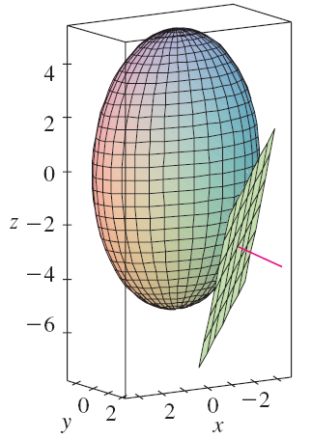
TANGENT PLANES
Example 8
The figure shows the ellipsoid, tangent plane, and normal line in Example 8.

Slide 109
SIGNIFICANCE OF GRADIENT VECTOR
We now summarize the ways in which the gradient vector is significant.

Slide 110
SIGNIFICANCE OF GRADIENT VECTOR
We first consider a function f of three variables and a point P(x₀, y₀, z₀) in its domain.

Slide 111
SIGNIFICANCE OF GRADIENT VECTOR
On the one hand, we know from Theorem 15 that the gradient vector gives the direction of fastest increase of f.

Slide 112
SIGNIFICANCE OF GRADIENT VECTOR
On the other hand, we know that is orthogonal to the level surface S of f through P.

Slide 113
SIGNIFICANCE OF GRADIENT VECTOR
These two properties are quite compatible intuitively.
As we move away from P on the level surface S, the value of f does not change at all.

Slide 114
SIGNIFICANCE OF GRADIENT VECTOR
So, it seems reasonable that, if we move in the perpendicular direction, we get the maximum increase.

Slide 115
SIGNIFICANCE OF GRADIENT VECTOR
In like manner, we consider a function f of two variables and a point P(x₀, y₀) in its domain.

Slide 116
SIGNIFICANCE OF GRADIENT VECTOR
Again, the gradient vector gives the direction of fastest increase of f.

Slide 117
SIGNIFICANCE OF GRADIENT VECTOR
Also, by considerations similar to our discussion of tangent planes, it can be shown that:
is perpendicular to the level curve f(x, y) = k that passes through P.

Slide 118
SIGNIFICANCE OF GRADIENT VECTOR
Again, this is intuitively plausible.
The values of f remain constant as we move along the curve.

Slide 119
SIGNIFICANCE OF GRADIENT VECTOR
Now, we consider a topographical map of a hill.
Let f(x, y) represent the height above sea level at a point with coordinates (x, y).

Slide 120
SIGNIFICANCE OF GRADIENT VECTOR
Then, a curve of steepest ascent can be drawn by making it perpendicular to all of the contour lines.

Slide 121
SIGNIFICANCE OF GRADIENT VECTOR
This phenomenon can also be noticed in this figure in Section 14.1, where Lonesome Creek follows a curve of steepest descent.

Slide 122
SIGNIFICANCE OF GRADIENT VECTOR
Computer algebra systems have commands that plot sample gradient vectors.
Each gradient vector is plotted starting at the point (a, b).

Slide 123
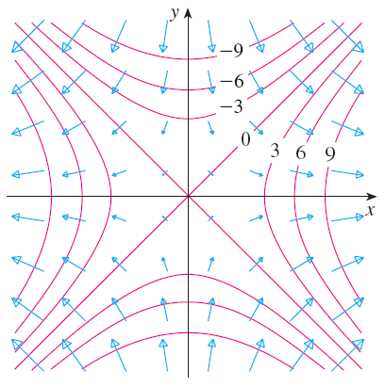
GRADIENT VECTOR FIELD
The figure shows such a plot—called a gradient vector field—for the function f(x, y) = x² – y² superimposed on a contour map of f.

Slide 124
SIGNIFICANCE OF GRADIENT VECTOR
As expected, the gradient vectors:
Point “uphill”
Are perpendicular to the level curves

